Slide 1
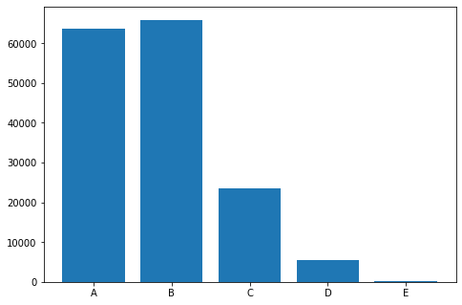

Slide 2
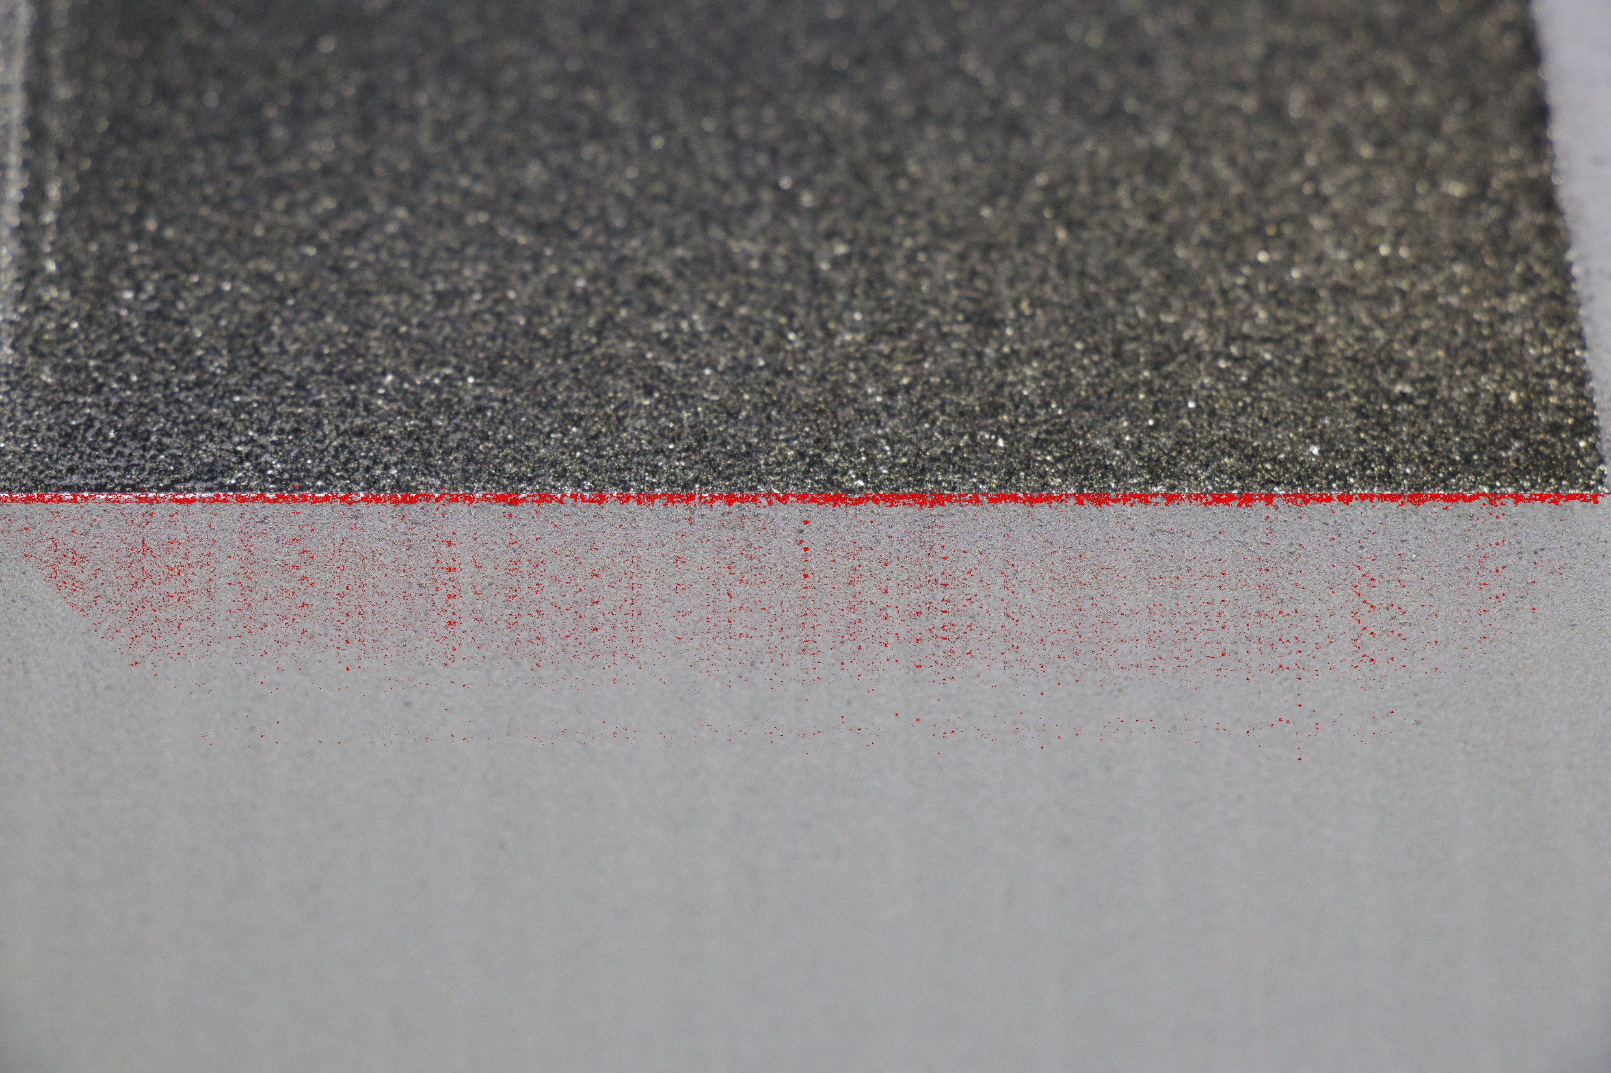
0 mm
2.7 mm
5.4 mm
8.1 mm
10.8 mm
13.5 mm

Slide 3
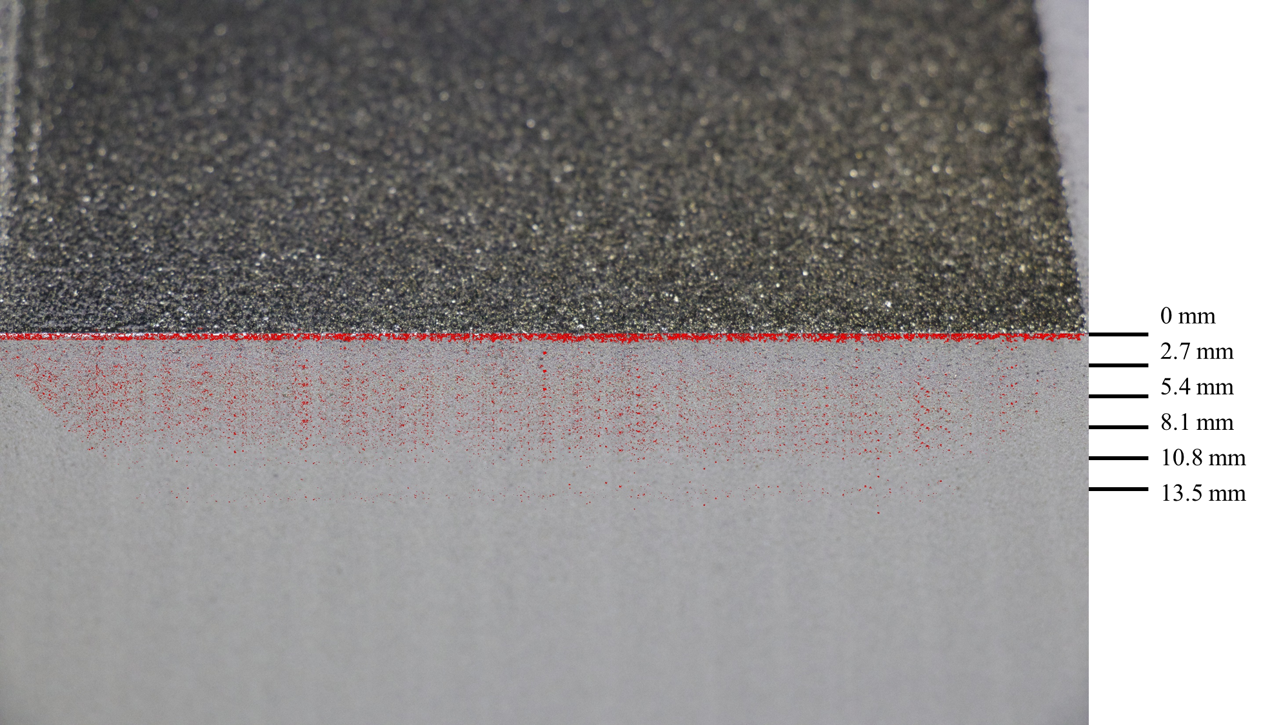

Slide 4
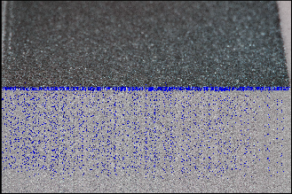

Slide 5
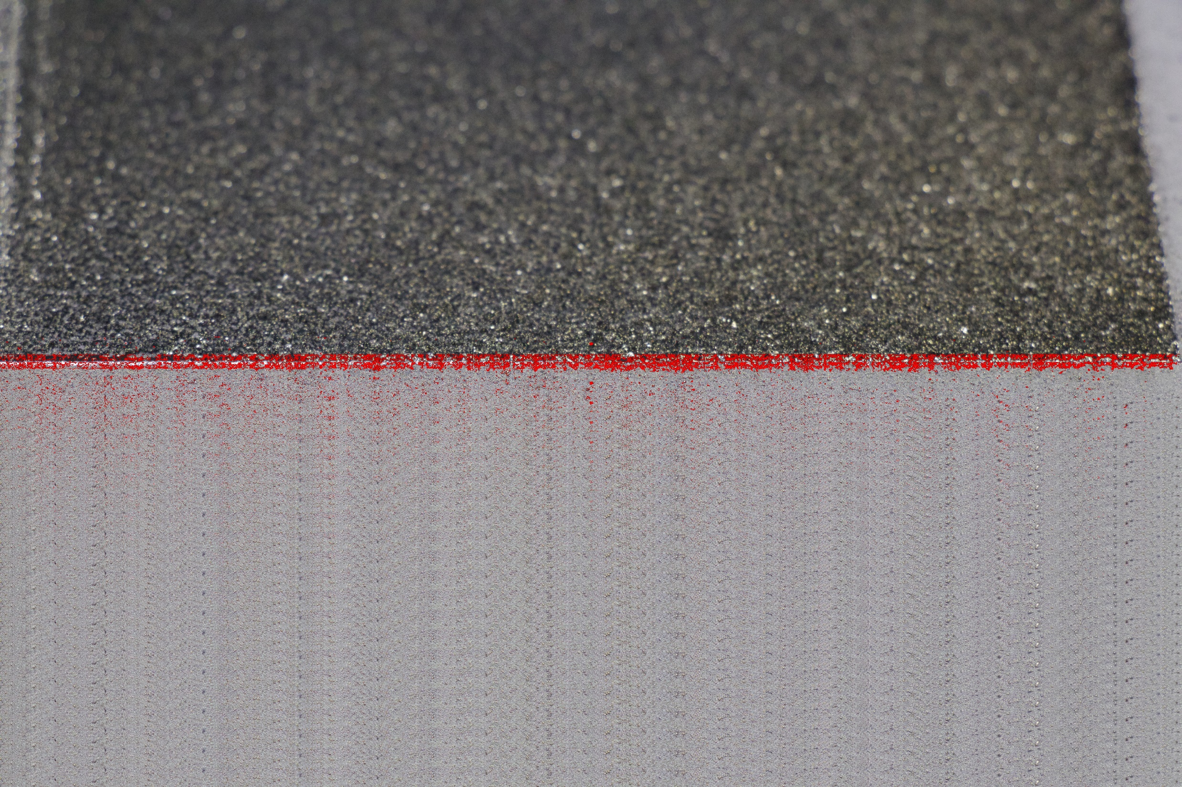
0 mm
2.7 mm
5.4 mm
8.1 mm
10.8 mm
13.5 mm

Slide 6

0 mm
2.7 mm
A
5.4 mm
8.1 mm
B
10.8 mm
13.5 mm
C
D
E

Slide 7
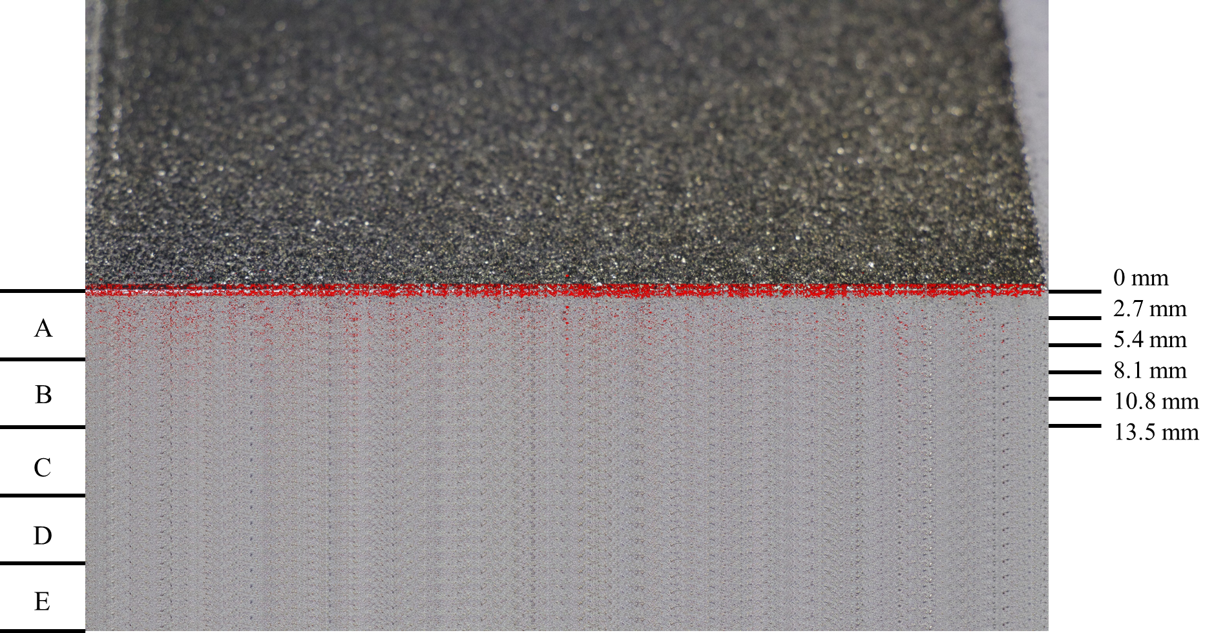

Slide 8
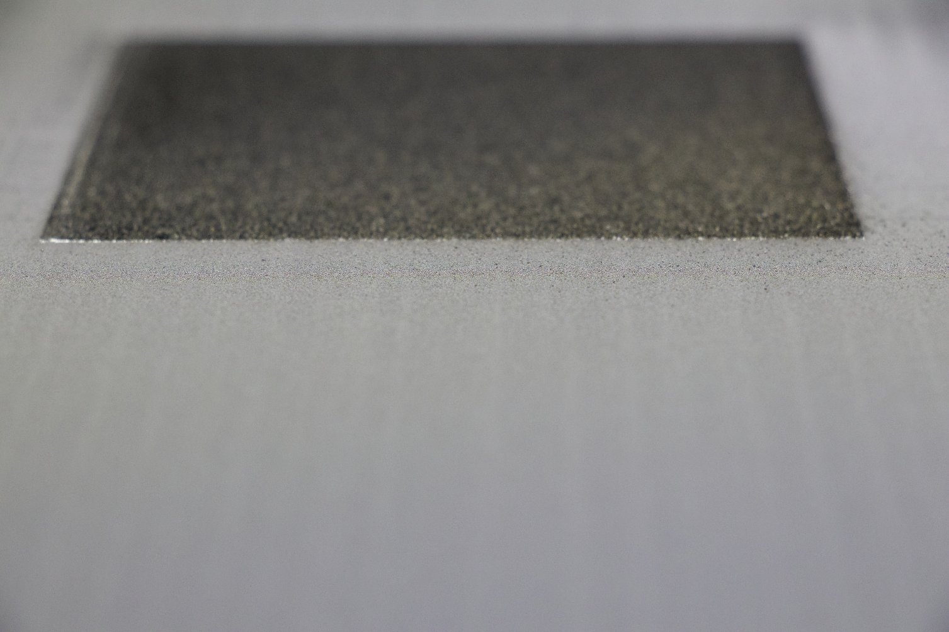
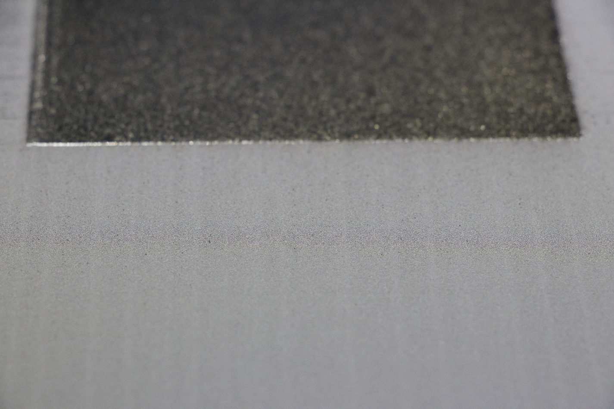
6112 (Focus)
6114 (Focus)

Slide 9
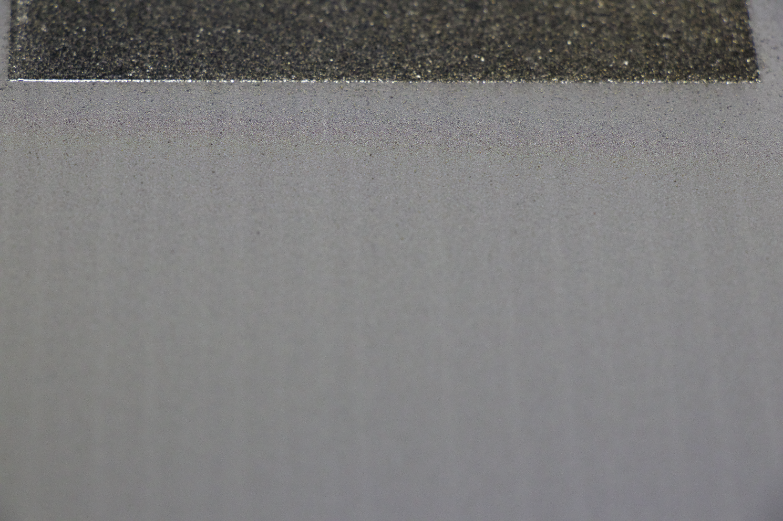
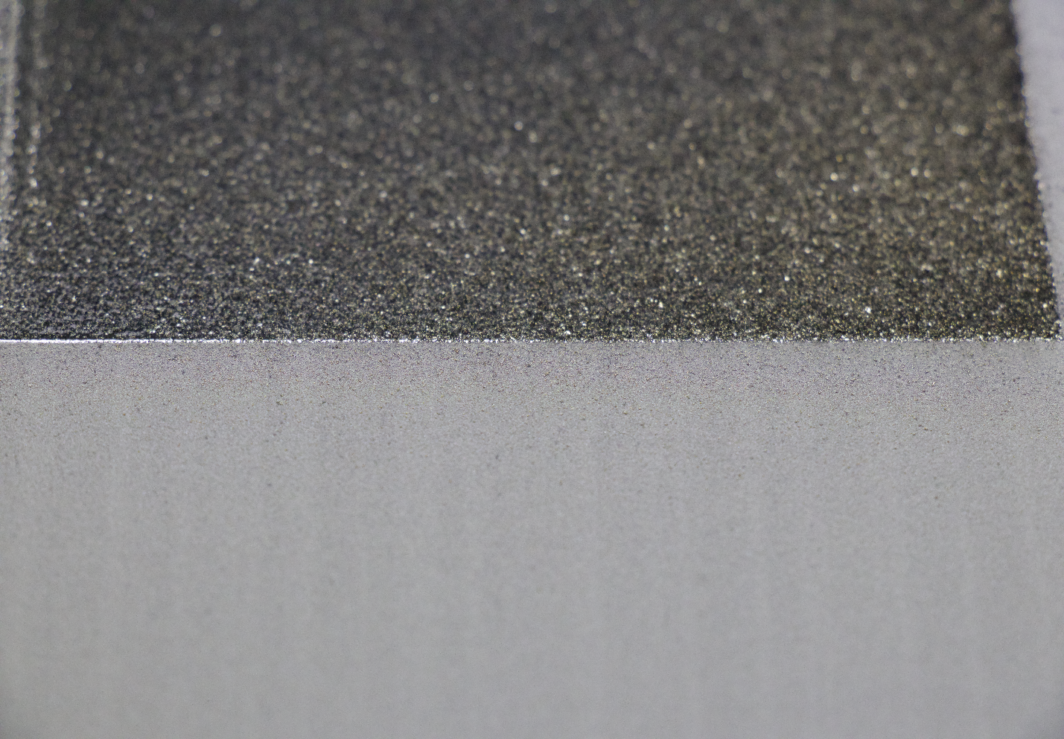
6115 (Focus)
6118 (Focus,主要分析的圖)

Slide 10
